Slide 1



PRESENTED BY
Kadi Sarva Vishwavidyalaya
And in coordination with
N P College of Computer Studies

Slide 2
PRESENT A PROJECT ON SUBJECT
C programming
BY
BCA Semester – 2
Subject Name : C programming
Subject Code : SEC201-1C
Group : D60

Slide 3
Group Details
Sr. No | Student Name | Enrolment Number | Roll Number | Exam Number
1 | Dhiraj Suthar | 23BCA24262 | 241 | F241
2 | Vinit Menon | 23BCA24099 | 239 | 1541092
3 | Divyanshu Rajput | 23BCA2 | 266 | 1541216
4 | Suraj Chavda | 23BCA24021 | 224 | 1541020

Slide 4
Project Title
Project Title: C programming
Task 1: a) Code | 5
b)Output | 6
Task 2: a) Code | 7
b)Output | 8
Task 3: a) Code | 9
b)Output | 10
Task 4: a) Code | 11
b)Output | 12
Task 5: a) Code | 13
b)Output | 14
Project Work Learning’s | 15

Slide 5
Task 1: Year and Months
printf("Enter age in years: ");
scanf("%d", &personAge.years);
}
else if (preference == 2)
{
printf("Enter age in months: ");
scanf("%f", &personAge.months);
}
else
{
printf("Invalid preference!\n");
return 1;
}
if (preference == 1)
{
printf("Age in years: %d\n", personAge.years);
printf("Age in months: %.2f\n", personAge.years * 12.0);
}
else
{
printf("Age in years: %d\n", (int)(personAge.months / 12));
printf("Age in months: %.2f\n", personAge.months);
}
return 0;
}
1srysfo0t?e=5mnj2c
a) Code:
#include <stdio.h>
union Age {
int years;
float months;
};
int main() {
union Age personAge;
int preference;
printf("Enter age:\n");
printf("1. Years\n");
printf("2. Months\n");
printf("Enter your preference from above : ");
scanf("%d", &preference);
if (preference == 1)
{

Slide 6
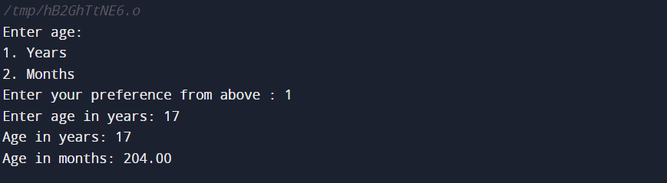
b) Output:

Slide 7
Task 2: Car Models
%d: ", i + 1);
scanf("%s", carMakes[i].make);
for (int j = 0; j < 3; j++)
{
printf("Enter model %d details (name, year, price): ", j + 1);
scanf("%s %d %f", carMakes[i].cars[j].model, &carMakes[i].cars[j].year, &carMakes[i].cars[j].price);
}
}
printf("\nInformation about all cars:\n");
for (int i = 0; i < 3; i++)
{
printf("\nManufacturer: %s\n", carMakes[i].make);
printf("-------------------------------------------------\n");
for (int j = 0; j < 3; j++)
{
printf("Model: %s\n", carMakes[i].cars[j].model);
printf("Year: %d\n", carMakes[i].cars[j].year);
printf("Price: %.2f\n", carMakes[i].cars[j].price);
printf("\n");
}
printf("-------------------------------------------------\n");
}
return 0;
}
a) Code:
#include <stdio.h>
struct Car {
char model[20];
int year;
float price;
}; struct CarMake {
char make[20];
struct Car cars[3];
}; int main()
{
struct CarMake carMakes[3];
for (int i = 0; i < 3; i++)
{
printf("Enter manufacturer of car

Slide 8
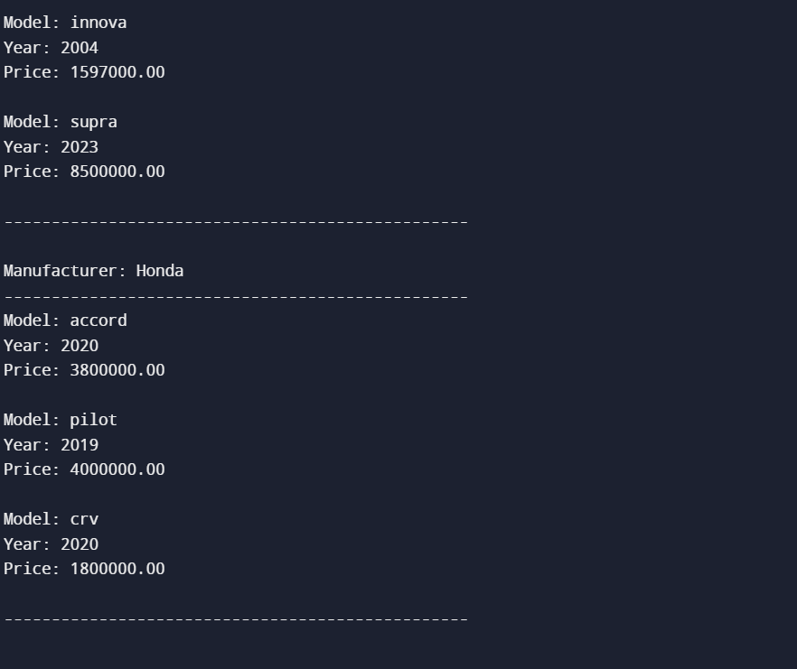
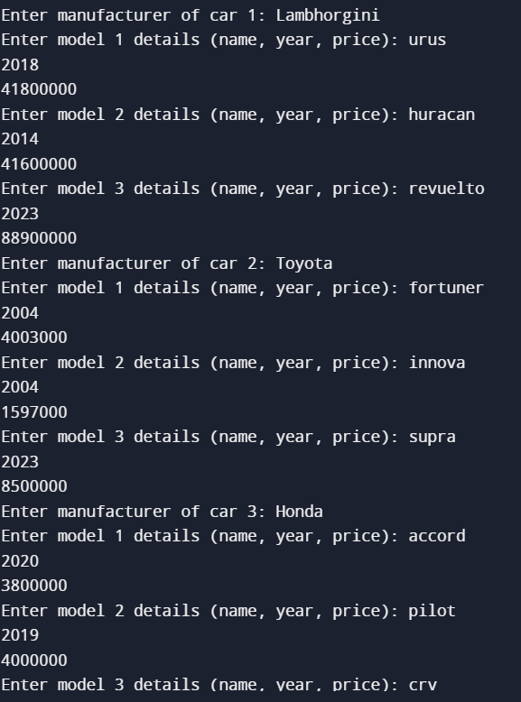
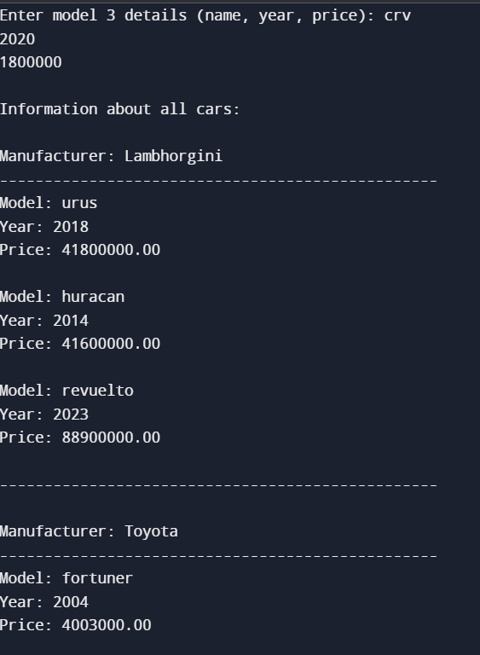
b) Output:

Slide 9
int main()
{
int i, n;
printf("Enter A Digit For Fibonnaci Series = ");
scanf("%d",&n);
printf("\n-------------------------------------------\n");
for(i=0;i<n;i++)
{
printf("\n%d",fibonnaci(i));
}
}
Task 3: Fibonaci series
a) Code:
#include <stdio.h>
int fibonnaci(int i)
{
if(i == 0)
{
return 0;
}
if(i == 1)
{
return 1;
}
return(fibonnaci(i-1) + fibonnaci(i-2));
}

Slide 10
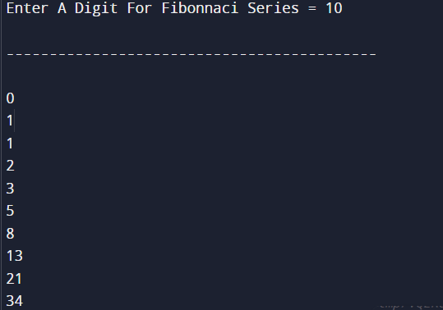
b) Output:

Slide 11
Task 4: Arithmatic UDF
int sub()
{
int a,b;
printf("Enter The Value Of A :");
scanf("%d",&a);
printf("Enter The Value Of B :");
scanf("%d",&b);
printf("Subtraction Of Two Value = %d\n",a-b);
}
int mul()
{
int a,b;
printf("Enter The Value Of A :");
scanf("%d",&a);
printf("Enter The Value Of B :");
scanf("%d",&b);
printf("Multiplication Of Two Value = %d\n",a*b);
} float div()
{
int a,b;
printf("Enter The Value Of A :");
scanf("%f",&a);
printf("Enter The Value Of B :");
scanf("%f",&b);
printf("Division Of Two Value = %f",a/b);
}
a) Code:
#include <stdio.h>
int sum();
int sub();
int mul();
float div();
int main()
{
sum();
sub();
mul();
div();
return 0;
}
int sum()
{
int a,b;
printf("Enter The Value Of A :");
scanf("%d",&a);
printf("Enter The Value Of B :");
scanf("%d",&b);
printf("Sum Of Two Value = %d\n",a+b);
}

Slide 12
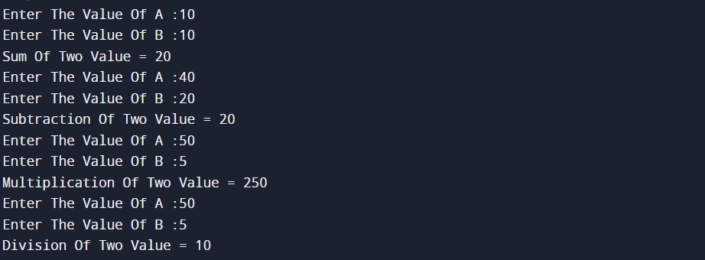
b) Output:

Slide 13
Task 5: Student info. Using Structure
a) Code:
#include <stdio.h>
struct student {
char name[50];
int rollno;
int phone;
char std[20];
float per;
};
int main()
{
struct student st[4];
int i;
printf("Enter The Information Of Four student :\n");
for(i=0;i<4;i++)
{
printf("\n Enter Name : ");
scanf("%s", &st[i].name);
printf("\n Enter Roll Number : ");
scanf("%d", &st[i].rollno);
printf("\n Enter Phone Number : ");
scanf("%d", &st[i].phone);
printf("\n Enter Class : ");
scanf("%s", &st[i].std);
printf("\n Enter Percentage : ");
scanf("%f", &st[i].per);
}
printf("Student Information List : ");
for(i=0;i<4;i++)
{
printf("Name : %s, Roll Number : %d, Phone Number : %d, Class : %s, Percentage : %f", st[i].name, st[i].rollno, st[i].phone, st[i].std, st[i].per);
printf("\n------------------------------------------------------------");
}
}

Slide 14
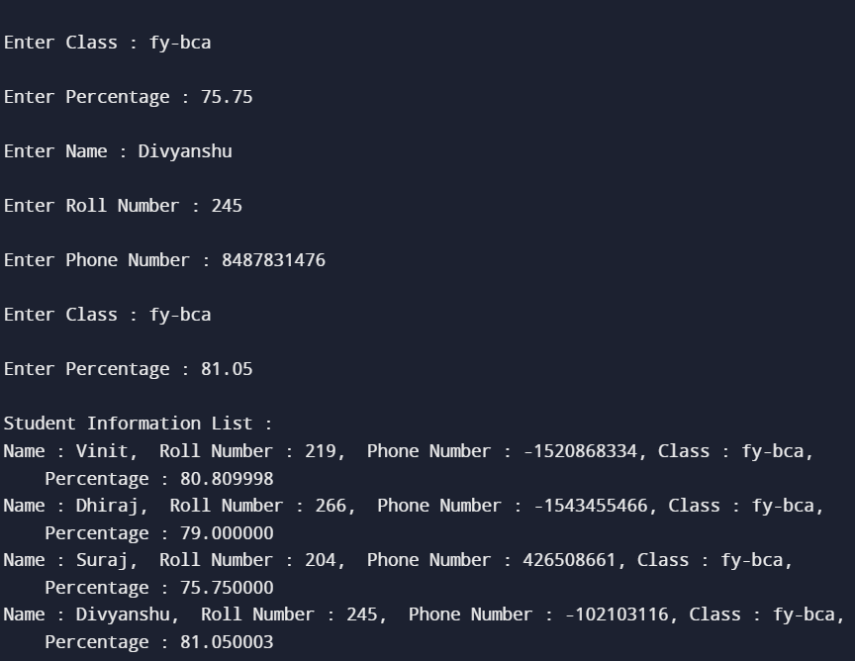
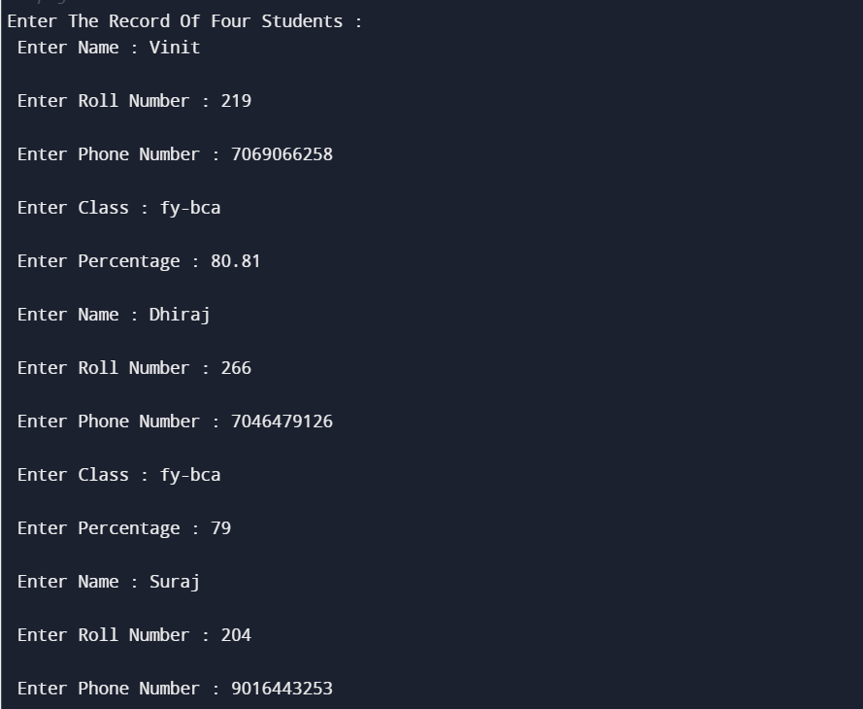
b) Output:

